Slide 1
Effectiveness of Marketing Campaigns by PopCrt from a Demographic Perspective
PopCrt

Slide 2
Problem
Are the marketing campaigns effective in increasing clicks and profits, depending on the target market?

Slide 3
Objectives
Determine which product categories are the most popular per market segment (e.g. gender, location, and age group). | Determine which campaigns are performing best by gender. | Determine which age groups are more likely to interact with the marketing campaigns.

Slide 4
Data Analysis Goals
What is the overall click-through rate (CTR) for the campaigns launched by the company? | What is the CTR for each product category? | What percentage of the total revenue generated during campaign periods is contributed by female customers? | Which campaign has generated the most impressions?
How many unique users per location viewed the campaign with the most impressions? | What are the total impressions and CTR for each product category per location? | What are the total impressions and CTR for each product category per age group? | What are the total impressions and CTR for each product category per gender?

Slide 5
Click-Through Rate (CTR)
Number of Clicks
X 100%
Total Impressions*
*Total Impressions = Number of times content is displayed, clicked or not.

Slide 6
Methodology
PostGreSQL was used to clean and preprocess data (i.e. Join Sales Data with Marketing Impressions data) | Click-Through Rate (CTR) for marketing campaigns and product categories (overall and per-item) | Percentage of total revenue from campaign periods generated by female customers (overall and per marketing campaign)
Determine campaign with the highest impressions and get the number of unique users per region who viewed the campaign | Calculate CTR and Total Impressions for each product category per location, age group, and gender | Visualize results with Excel

Slide 7
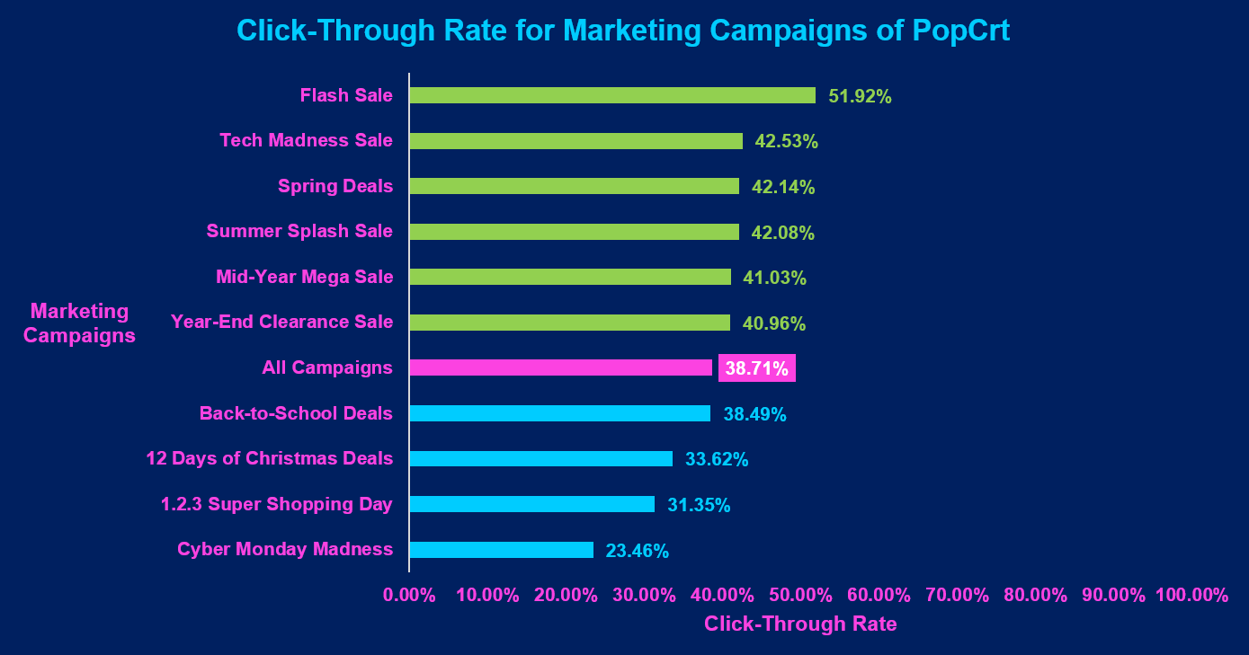

Slide 8
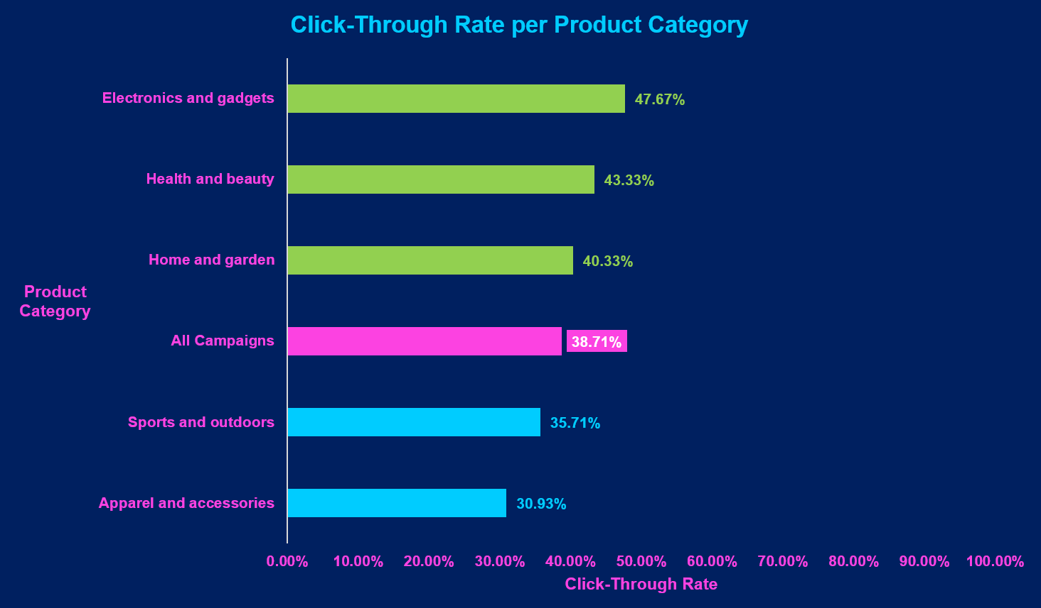

Slide 9
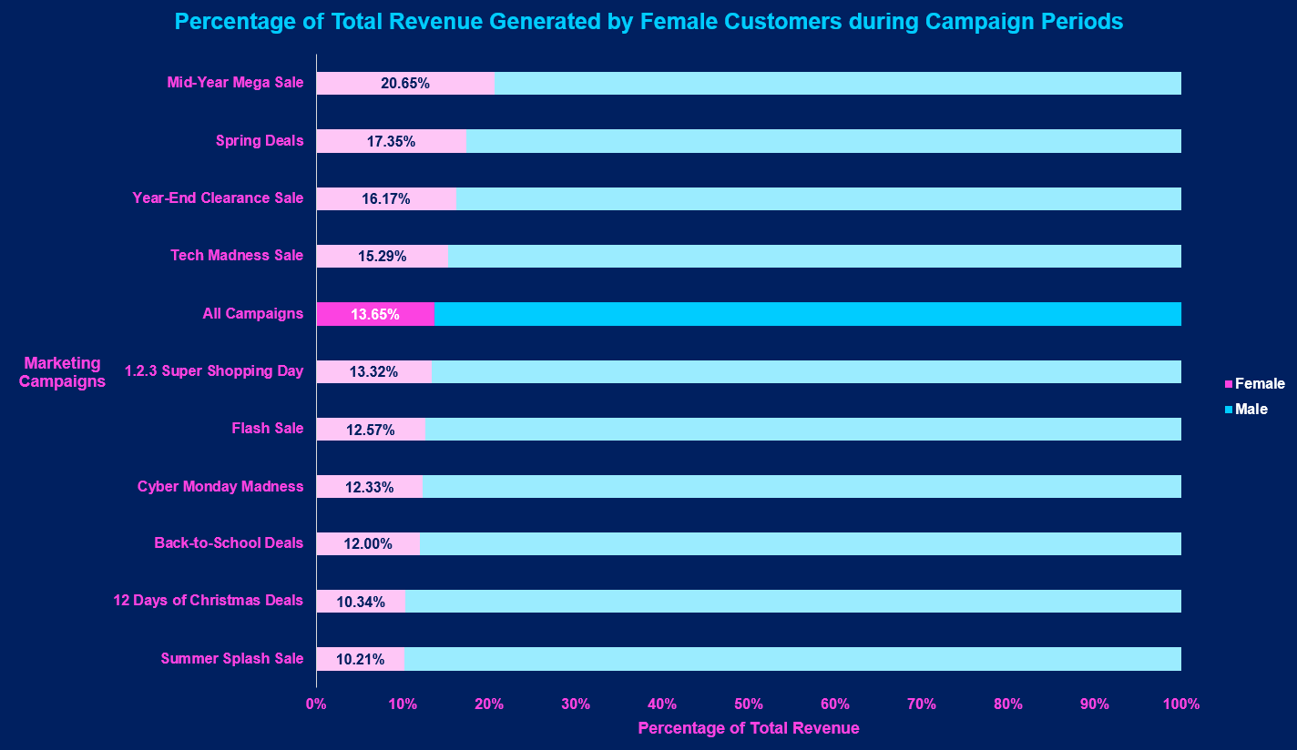

Slide 10
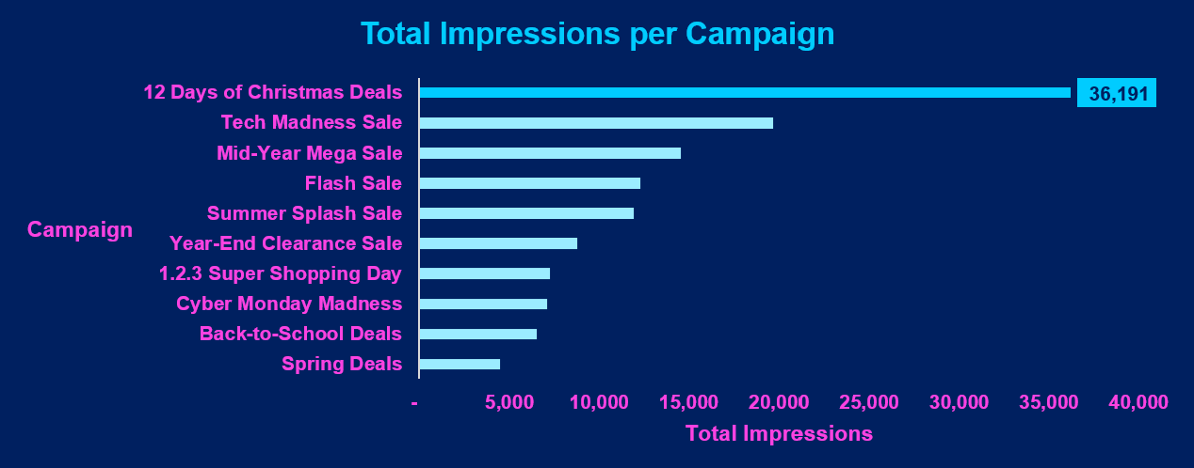

Slide 11
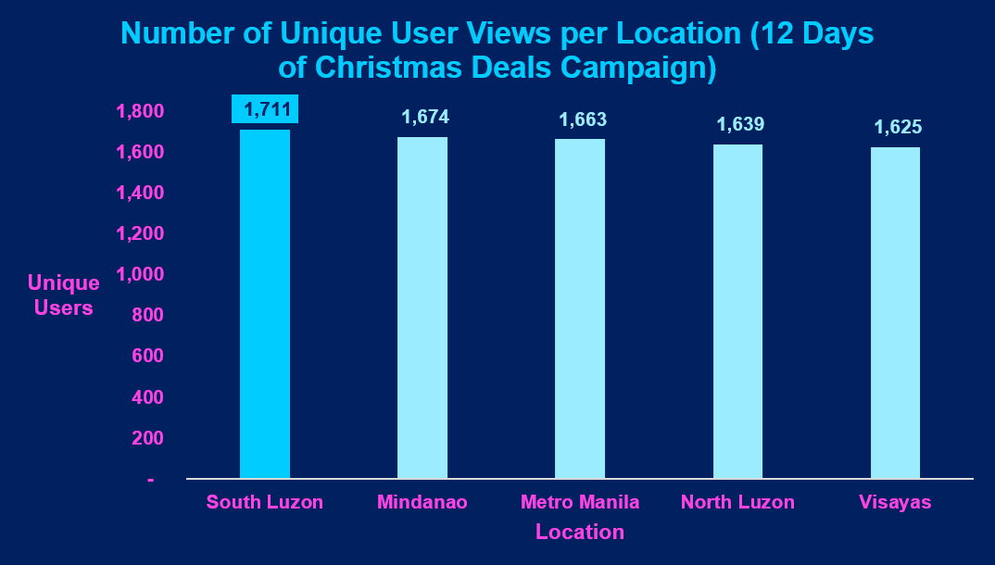

Slide 12
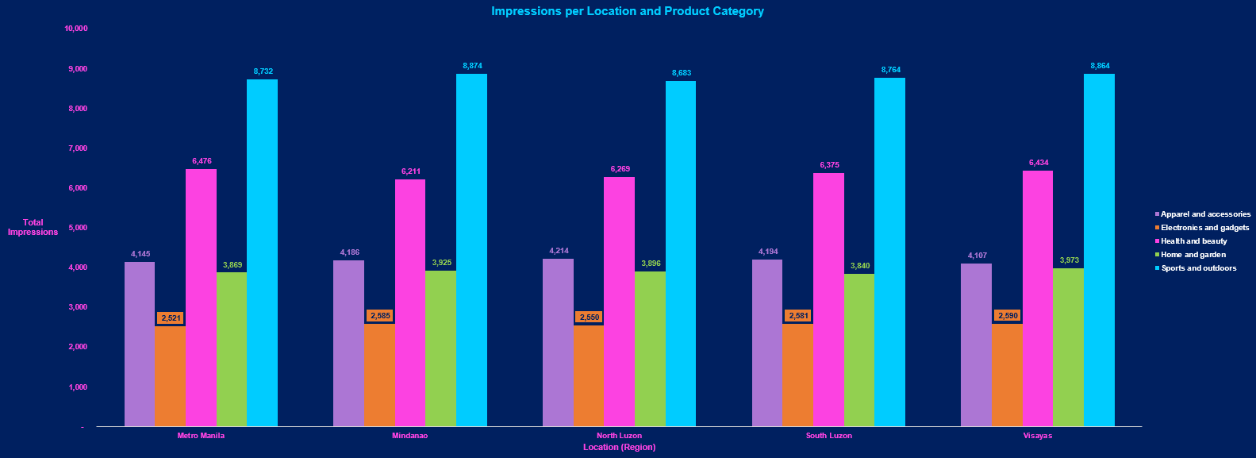

Slide 13
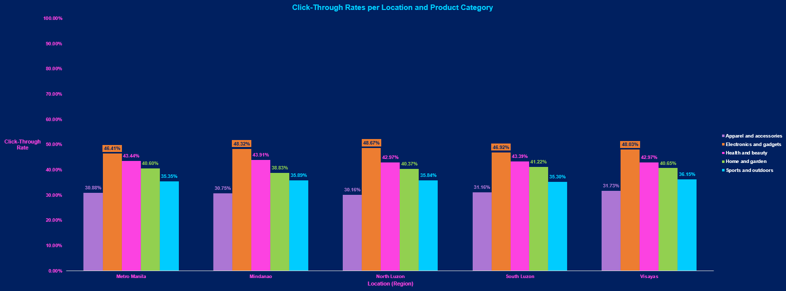

Slide 14
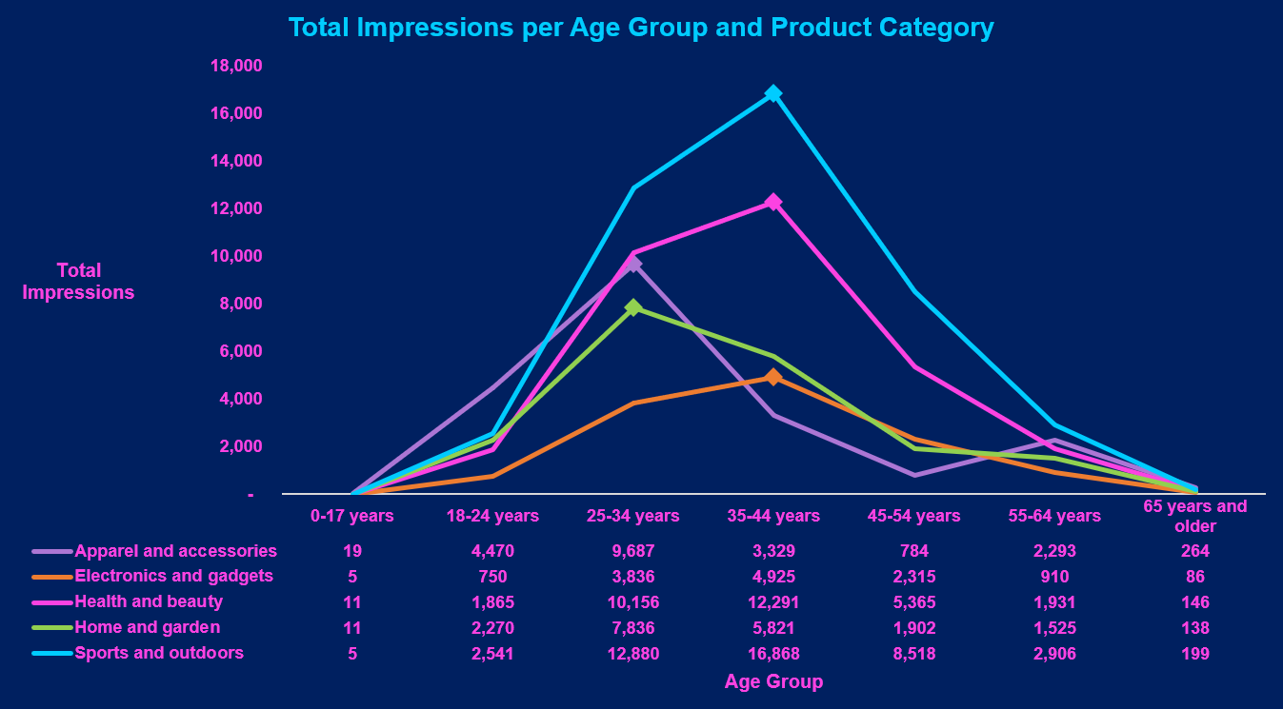

Slide 15
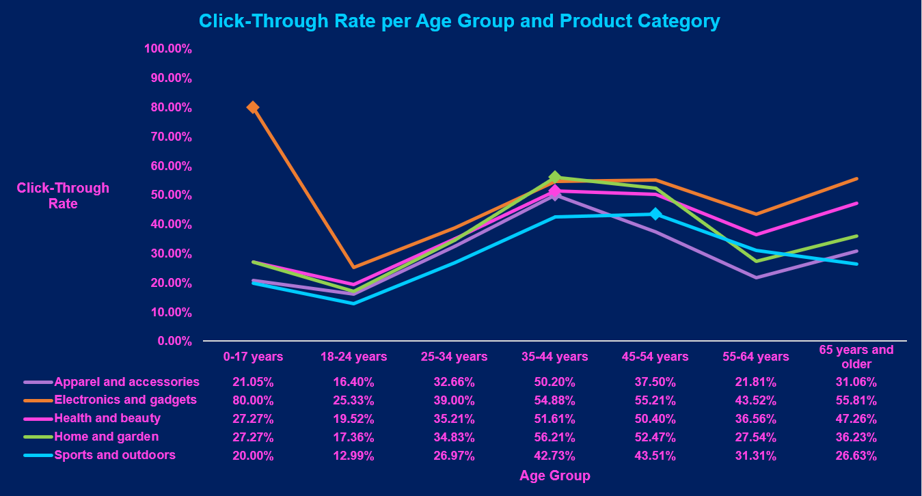

Slide 16
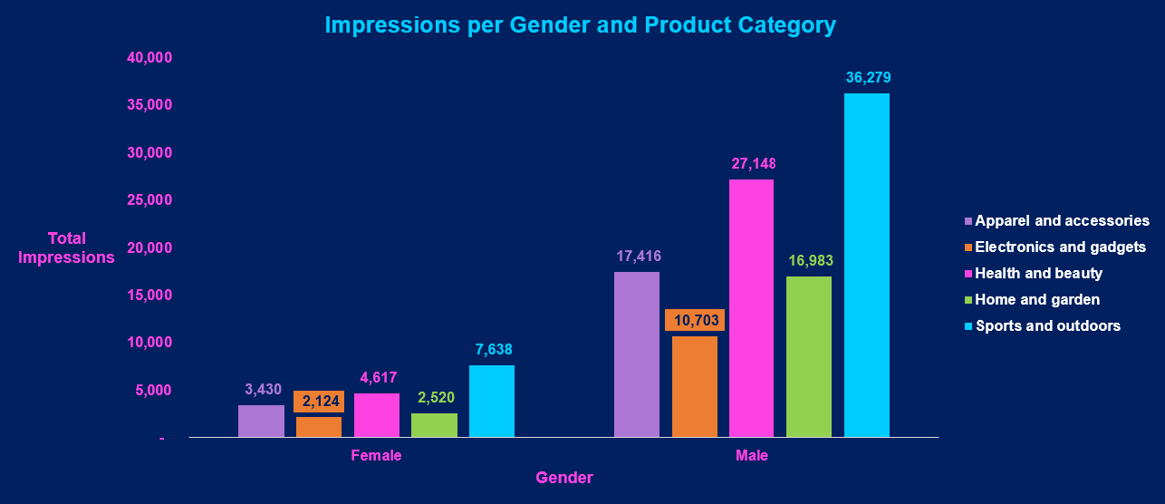

Slide 17
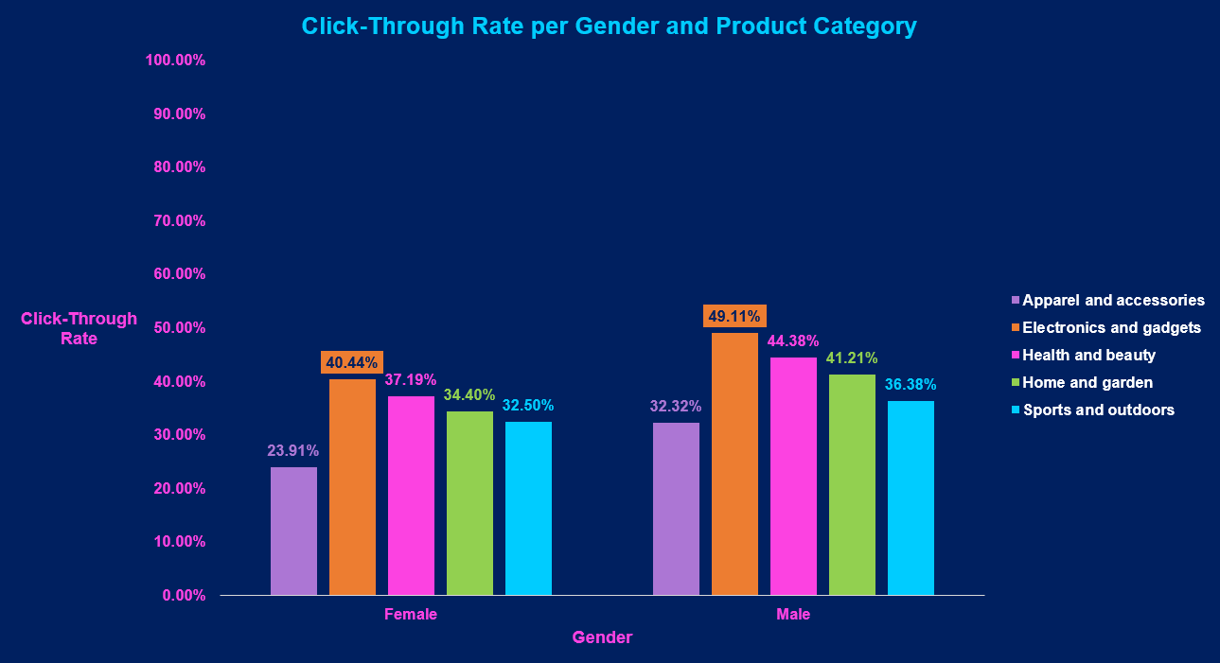

Slide 18
Recommendations
Focus more effort on marketing campaigns involving the Electronics and Gadgets product category, most especially in the 0-17 age group.
Increase marketing campaign efforts on female users to potentially increase their chances of purchasing from the store.
Adopt the marketing strategies utilized in Flash Sales to improve the CTR of marketing campaigns below the CTR of all campaigns, most notably the 12 Days of Christmas Deals which had the highest impressions but has one of the below-overall CTR values.

